Slide 1
Create Micro Apps with Spring Boot

Slide 2
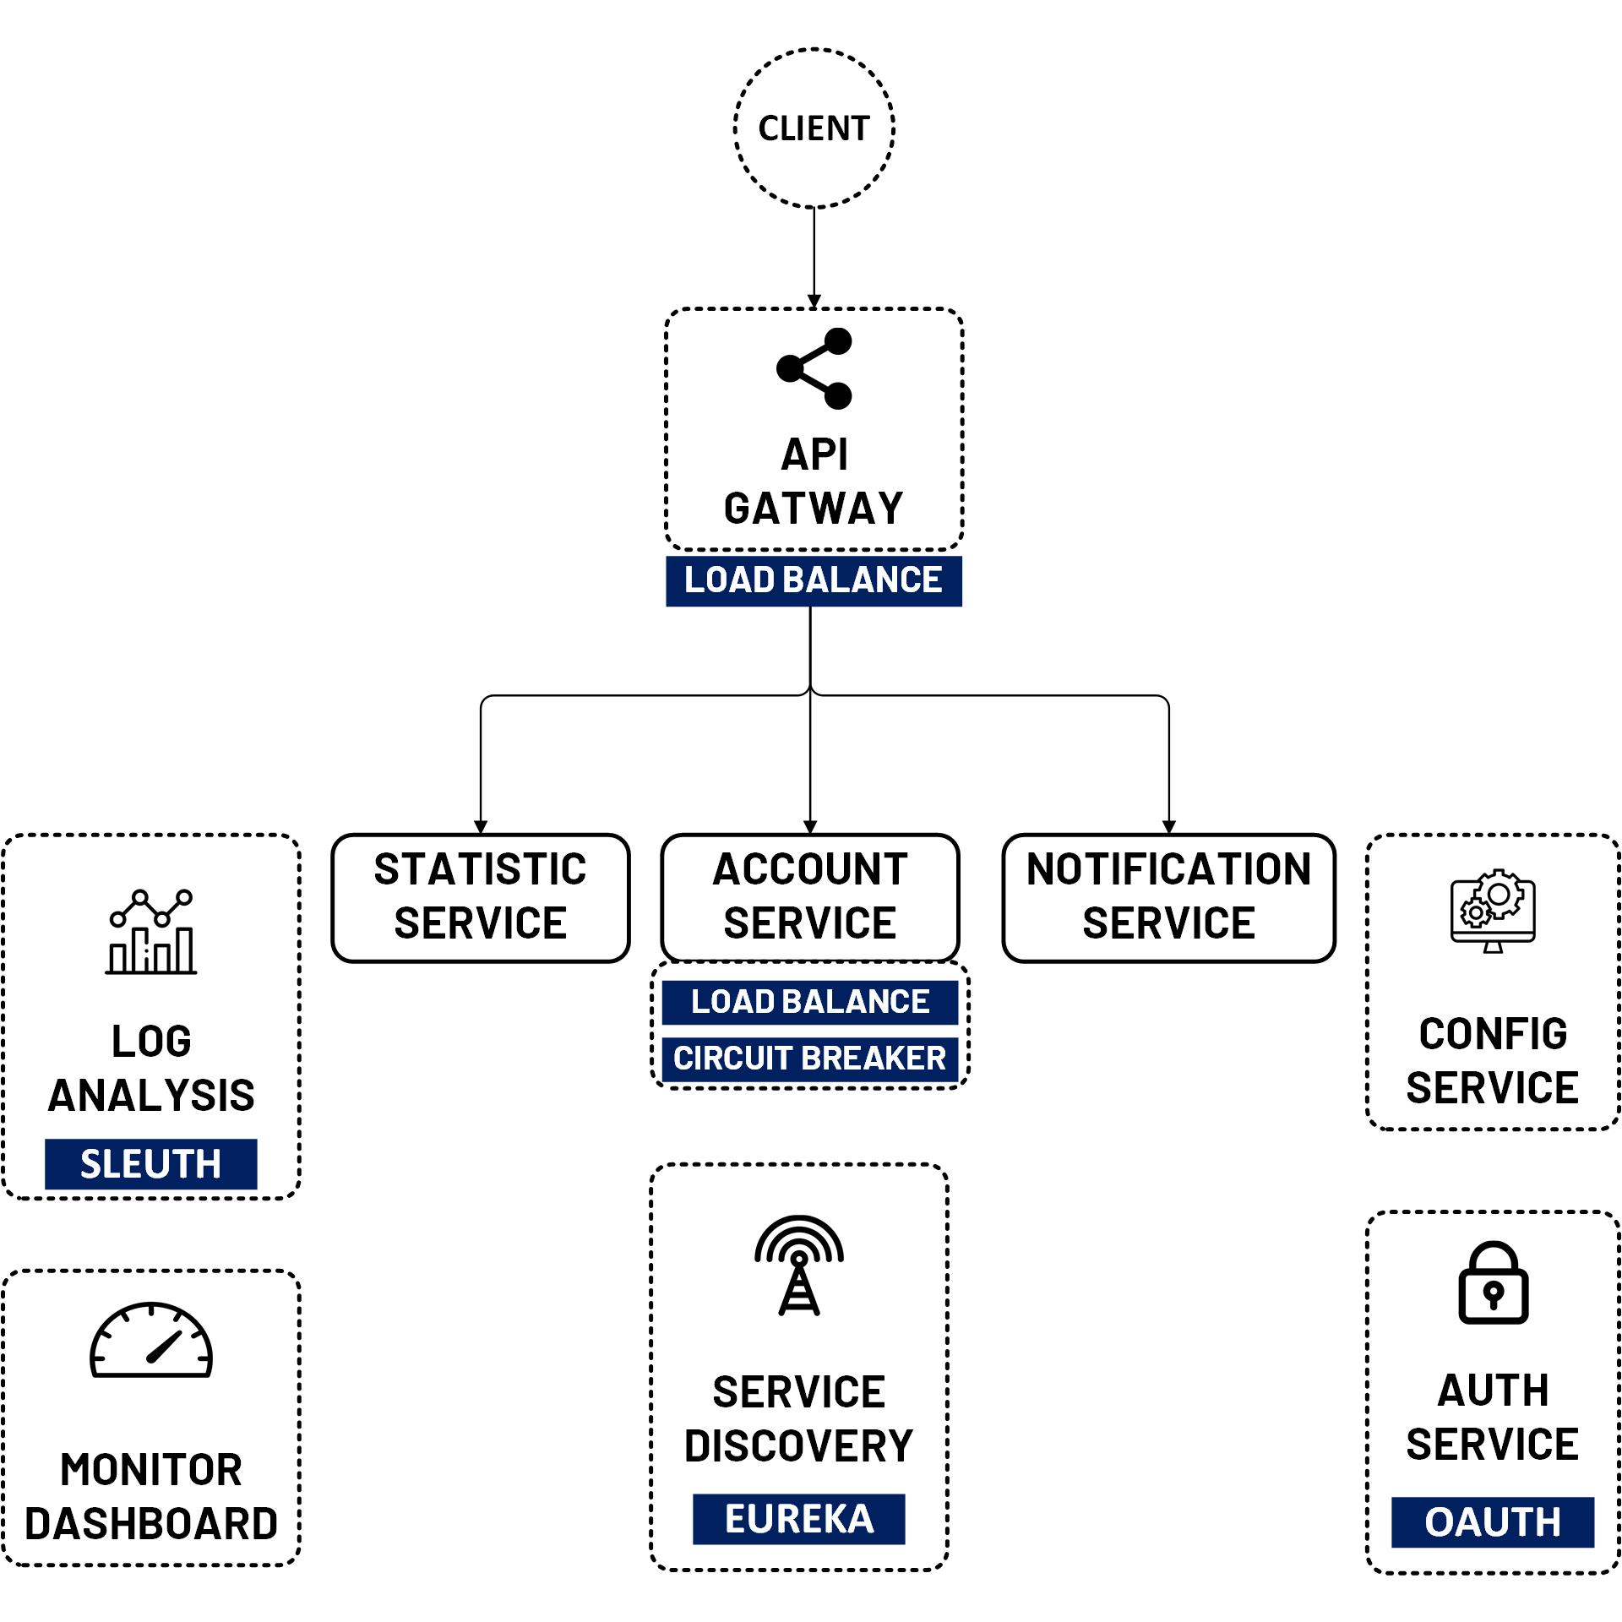
Let’s review some parts
Web Service & REST
How to create a REST Web Service with Spring Boot.
How to call API with Postman tool.
Develop Micro Service Apps with Spring Boot
Create 3 Micro Service Apps:
1. Account Service: Manage User in System
2. Notification Service: Manage Email Notification to user
3. Statistics Service: Manage User Logs (create, update, delete, Search)

Slide 3
Setup Environment
JDK 1.8
https://www.oracle.com/java/technologies/downloads/#java8
MySQL & MySQL Workbench 8
https://dev.mysql.com/downloads/windows/installer/8.0.html
Spring Tool Suite 4
https://spring.io/tools
Or Eclipse
Or IntelliJ IDEA

